Slide 1

Uniformed Search
Poppy is into it.

Slide 2
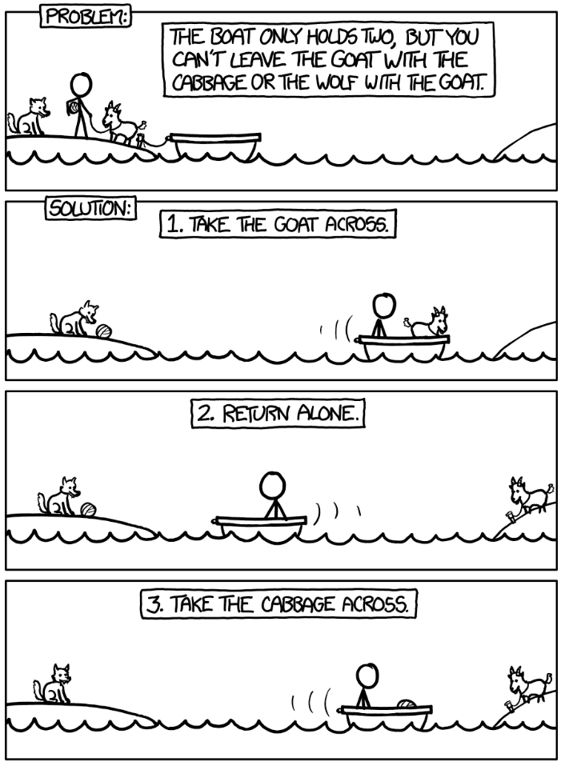
A Motivating Example
https://xkcd.com/1134/

Slide 3
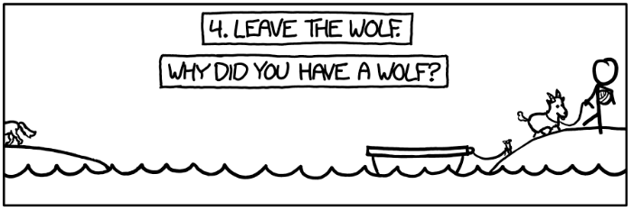

Slide 4







Search Example: Jugs
Given: 5-gallon jug and 2-gallon jug
State Representation: $\left(f, t\right)=$ (#gallons in 5-gal, #gallons in 3-gal)
5
2
Goal: Acquire 1 gallon
Goal States: $\left(∗,1\right)$ or $\left(1, ∗\right)$, where $∗$ refers to any amount in the jug.
Initial State: $\left(5,0\right)$
Transitions:
Empty the 5-gallon jug
$$\left(f,t\right)→\left(0,t\right)$$
Empty the 2-gallon jug
$$\left(f,t\right)→\left(f,0\right)$$
Pour 2-gallon jug into 5-gallon jug
$\left(f,2\right)→\left(f+2,0\right)$, where $f≤3$
Pour 5-gallon jug into 2-gallon jug
$\left(f,0\right)→\left(f−2,2\right)$ , where $f≥2$
Pour 1 gallon from 5-gallon jug into 2-gallon jug
$\left(1,0\right)→\left(0,1\right)$
(These transitions imply you cannot measure or pour a specific amount of water from a jug.)

Slide 5
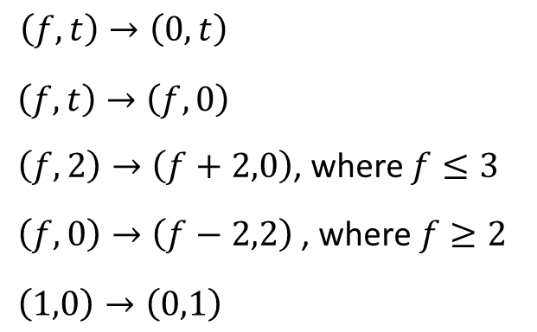

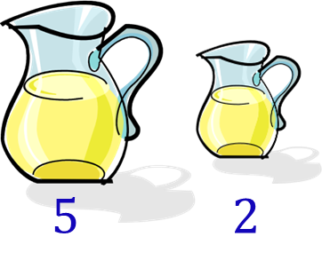












T1
T2
T3
T4
T5
BFS Search of Jugs
$$\left(5,0\right)$$
T1
T3
T4
T5
T2
$$\left(0,0\right)$$
$$\left(5,0\right)$$
$$\left(3,2\right)$$
$$f=5≰3$$
Does not apply
No water!
Redundant State
T1
T2
T3
$$\left(0,2\right)$$
$$\left(3,0\right)$$
$$\left(5,0\right)$$
T2
T1
T4
T3
$$\left(0,0\right)$$
$$\left(2,0\right)$$
$$\left(0,0\right)$$
$$\left(1,2\right)$$
Redundant State
No water!
+ Redundant
Oscillation: Redundant States
No water!
+ Redundant

Slide 6
Search is Almost Everywhere AI
  Core Search Problems—These are fundamentally about exploring sequences of actions/choices to reach a goal state.
  Game Playing: How should I move my chess piece?
  Robotics: How should a robot navigate a room?
  Planning: How should I schedule tasks?
  Resource Allocation: How should I assign tasks to processors?
  Automated Theorem Proving: How do I prove this mathematical statement?
  Search-Assisted Problems—These primarily use other techniques (neural nets, statistical learning) but may incorporate search as a component.
  Natural Language: How should I parse this sentence? (May use a beam search.)
  Machine Learning: How should I find optimal parameters? (Gradient descent in ML.)
  Hybrid/Search-Optional Problems—These can be solved with search or non-search methods. Modern approaches often blend techniques: search for exploration plus learning for evaluation.
  Computer Vision: How should I recognize objects in this image?
  Web Search: How should I rank these millions of pages?
  Recommendation Systems: What movie should I suggest next?
  Drug Discovery: Which molecular structure will treat this disease?

Slide 7
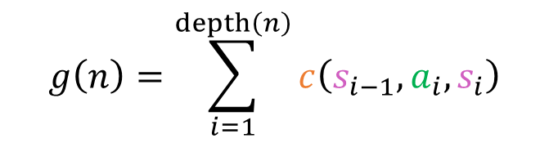








Formal Definition of Search
For:
$S$: State space (set of all possible states)
$s_{0}∈S$: Initial State
$Goals⊆S$: Set of goal states
$Actions\left(s\right)$: Set of legal actions in a state $s$
$δ\left(s,a\right)→s′∈S:$ Transition function $δ$ that applies action $a$ to state $s$ resulting in a state $s′$.
$c\left(s,a,s′\right):$ an action cost function; cost of $δ\left(s,a\right)→s′$
A search algorithm finds a sequence of actions:
$\left\langle a_{1},a_{2}, …, a_{n}\right\rangle$ such that $δ\left(…δ\left(δ\left(s_{0},a_{1}\right),a_{2}\right)…, a_{n}\right)∈Goals$
With a cost of:
$$g\left(n\right)=\sum_{i=1}^{depth\left(n\right)}{c\left(s_{i−1}, a_{i}, s_{i}\right)}$$
$$a_{1}$$
$$a_{2}$$
$$a_{n}$$
for the path $s_{0}→s_{1}→…→s_{n}$

Slide 8
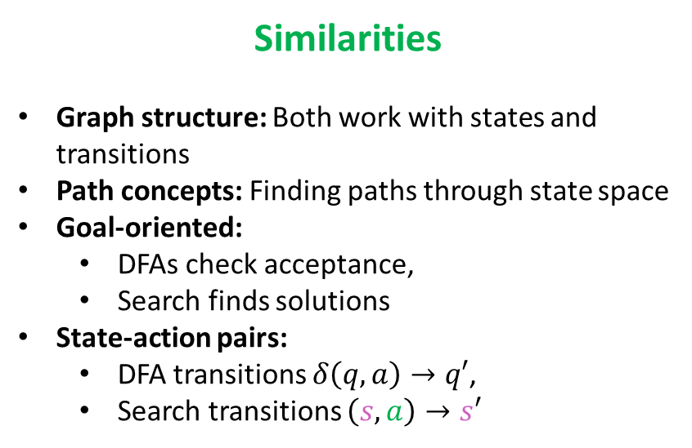
Formal Search Compared to DFAs
Similarities
Graph structure: Both work with states and transitions
Path concepts: Finding paths through state space
Goal-oriented:
  DFAs check acceptance,
  Search finds solutions
State-action pairs:
  DFA transitions $δ\left(q,a\right)→q′$,
  Search transitions $\left(s,a\right)→s′$
Key Differences
Input vs. Choice:
  DFA reads string,
  Search chooses actions
Determinism:
  DFA usually deterministic,
  Search often has multiple options
Costs:
  DFA has no costs,
  Search often optimizes path cost
Purpose:
  DFA recognizes ("Is string in language?"),
  Search constructs ("Find path to goal")
Search problems are like “interactive DFAs” where instead of passively consuming input, we actively choose actions to reach our goal states.

Slide 9

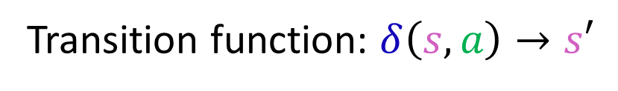
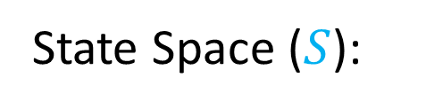


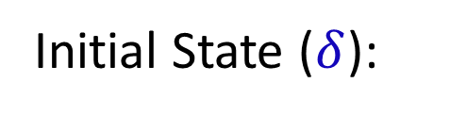
Search Example: GPS Navigation
State Space ($S$):
All possible locations
Initial State ($δ$):
Some location (e.g., home)
Goal Set ($Goals$):
A Mexican Restaurant
Actions($s$):
TurnLeft, TurnRight, GoStraight
Transition function: $δ\left(s,a\right)→s′$
Given a location, $s$, follow a direction to end up at $s′$
Path Cost:
Travel time, distance, gas cost, environmental impact, etc.
Solution:
Sequence of directions

Slide 10
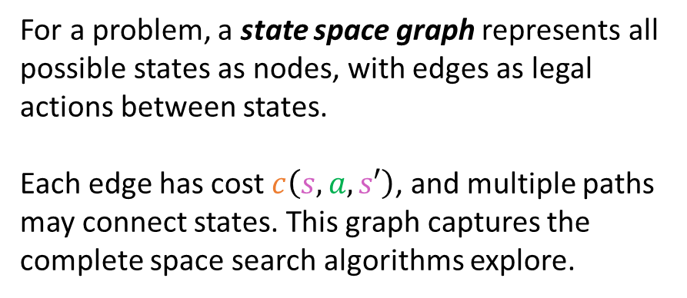
State Space Graph
3
G
S
5
A
For a problem, a state space graph represents all possible states as nodes, with edges as legal actions between states.
Each edge has cost $c\left(s,a,s′\right)$, and multiple paths may connect states. This graph captures the complete space search algorithms explore.
7
2
1
2
C
B
2
4
E
3
D
An optimal solution is the path from initial state to goal with minimum total cost—not necessarily the fewest actions. Some search algorithms guarantee finding optimal solutions; others do not.
The goal of search algorithms is to navigate the state space graph efficiently to find optimal (or acceptable) solution paths.
Paths to Goal:
Cost:
S → A → G
5 + 3 = 8
S → B → C → G
2 + 2 + 7 = 11
S → A → C → G
5 + 1 + 7 = 13
S → B → D → E → C → G
2 + 4 + 3 + 2 + 7 = 18
Optimal means minimum cost, not fewest actions.

Slide 11

















Search Trees
Given that the state space graph shows multiple paths to each state with different costs, search algorithms use a tree representation where each node tracks the complete path taken to reach that state.
$$s_{0}$$
$$a_{n}$$
$$a_{1}$$
$$a_{2}$$
$$a_{3}$$
$$a_{i}$$
$$s_{1}$$
$$s_{2}$$
$$s_{3}$$
$$…$$
$$s_{n}$$
$$a_{11}$$
$$a_{1j}$$
$$a_{12}$$
$$s_{x}$$
$$s_{y}$$
$$…$$
  Each node represents a state
  Each edge represents an action
  Each path represents a sequence of actions

Slide 12
Types of Search Problems I
Search by Environment Properties refers to what we know about the problem:
  Observability: Can we see the current state completely?
  Determinism: Do actions have predictable outcomes?
  Types:
  Single-State Problems (Fully observable, deterministic):
    8-puzzle: See all tiles, moves are predictable
    Route planning: Know current location, roads are fixed
  Multiple-State Problems (Partially observable, deterministic):
    Robot localization: Limited sensors, do not know exact position
    Sensorless planning: Robot vacuum with no position sensors
  Contingency Problems (Observable, nondeterministic):
    Medical diagnosis: Can observe symptoms, treatment outcomes uncertain
    Game against opponent: See game state, opponent's moves unpredictable
  Exploration Problems (Unknown state space):
    Mars rover navigation: Don't know terrain beforehand
    Web crawling: Discover links as you go

Slide 13
Types of Search Problems II
  Types:
  Finding Any Solution:
    Maze solving: Any path to exit
    Satisfiability (SAT): Any assignment that satisfies clauses
    Scheduling: Any valid assignment of tasks to resources
  Finding Optimal Solution:
    Shortest path: GPS navigation finding fastest route
    Traveling salesman: Minimum-cost tour visiting all cities
    Resource allocation: Minimum cost assignment
  State-Space Search vs. Path-Cost Search:
    Some problems care about reaching goal states (puzzles)
    Others care about path taken (navigation, planning sequences)
  Single Solution vs. All Solutions:
    Chess: Find one good move
    Constraint satisfaction: Sometimes need all valid solutions
    Game tree analysis: Explore all possible outcomes
Search By Objective refers to what type of solution we want:
Any valid solution vs. the best solution
One answer vs. exploring all possibilities
Final answer vs. improving answers over time

Slide 14
Search Strategies
Some search algorithms are like exploring a new city without a map (systematic but blind), while
others are like having a compass pointing toward your destination (guided exploration).
Uninformed Search (Blind Search)
  No problem-specific knowledge beyond definition
  Only knows actions, goal test, and action costs
  BFS: Explore level by level
  DFS: Go deep first, backtrack when stuck
  Uniform Cost Search: Always expand lowest-cost path
Informed Search (Heuristic Search)
  Uses problem-specific knowledge (heuristic function)
  Estimates “goodness” of states
  A*: Combines actual cost + estimated remaining cost
  Greedy Best-First: Always move toward seemingly closest goal
  Hill Climbing: Always take the best local step

Slide 15
Tree Search vs. Graph Search
Tree Search:
  Generates nodes without checking for duplicates
  Can visit same state multiple times
  Simpler implementation
Graph Search:
  Maintains explored set to avoid repeated states
  More efficient for state spaces with many paths to same state
  Higher memory requirements
A
TS: Duplicate visits possible.
B
C
GS: visit each state once
(Like a forgetful housekeeper who cleans the same room multiple times.)
D
E
F
G
H
(Like checking off rooms on a list as you clean them.)
Which approach would you use?
8-puzzle (many paths to same state)?
Graph Search - avoids revisiting solved positions
Infinite state space?
Depends - Graph search if cycles exist, Tree search if linear paths
Robot navigation in known environment?
Graph Search - prevents revisiting same locations
Exploring unknown territory?
Tree Search - unknown if cycles exist, save memory

Slide 16
The Frontier in Search
Definition. The frontier (sometimes called fringe) is the set of all nodes that have been identified but not yet expanded in a search algorithm: leaf nodes in a search tree.
(It represents a “boundary” between explored and unexplored parts of the search tree.)
# Generic search algorithm
frontier = [initial_state]
explored = set()
while frontier:
node = frontier.pop() # Central component to Search
if goal_test(node.state): return node
explored.add(node.state)
for action in actions(node.state):
child = child_node(node, action)
if child.state not in explored and child not in frontier:
frontier.add(child)
Data structure determines the search strategy

Slide 17
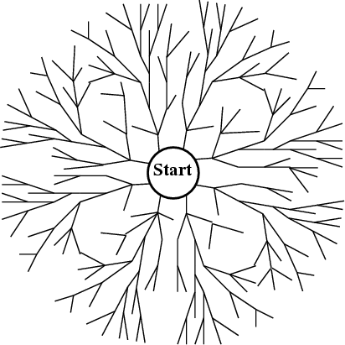
BFS
BFS: Expand the shallowest node first
  Examine states one step away from the initial states
  Examine states two steps away from the initial states
  … rippling outward
Goal
# Generic search algorithm
frontier = [initial_state]
explored = set()
while frontier:
node = frontier.pop() # Central component to Search
if goal_test(node.state): return node
explored.add(node.state)
for action in actions(node.state):
child = child_node(node, action)
if child.state not in explored and child not in frontier:
frontier.add(child)
BFS: Frontier = FIFO queue
We need back pointers to recover the solution path.

Slide 18
Performance
Four measures of search algorithms:
Completeness: Does the algorithm guarantee finding a solution if one exists? (Not necessarily finding all solutions.)
Optimality: Does it find the best solution?
Time complexity: How runtime scales with problem size.
Space complexity: How much memory is required.

Slide 19
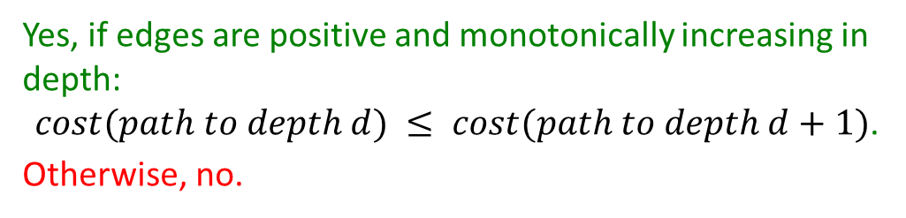
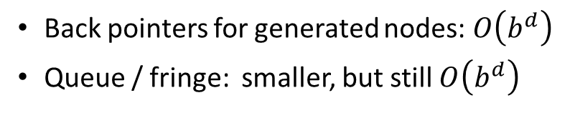
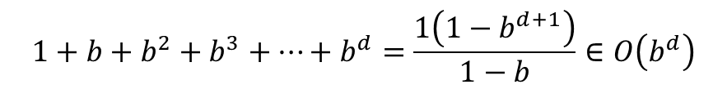
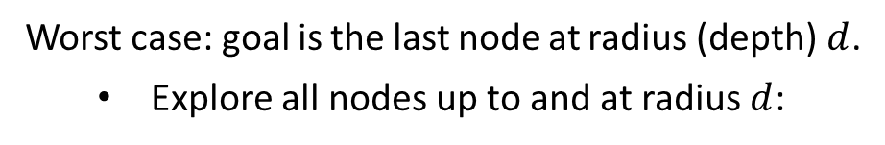
BFS Performance
Completeness: Does the algorithm guarantee finding a solution if one exists?
Yes.
Yes, if edges are positive and monotonically increasing in depth:
$cost(path to depth d) ≤ cost(path to depth d+1)$.
Otherwise, no.
Optimality: Does it find the best solution?
Solution: Uniform Cost Search
Time complexity
Space complexity
Worst case: goal is the last node at radius (depth) $d$.
  Explore all nodes up to and at radius $d$:
  Back pointers for generated nodes: $O\left(b^{d}\right)$
  Queue / fringe: smaller, but still $O\left(b^{d}\right)$
$$1+b+b^{2}+b^{3}+…+b^{d}=\frac{1\left(1−b^{d+1}\right)}{1−b}∈O\left(b^{d}\right)$$
(bad)
Solution: Depth-First Search

Slide 20
DFS
BFS: Expand the deepest node first
  Select a direction. Go deep until the end.
  Slightly change the end.
  Slightly change the end some more… fanning outward
Goal
# Generic search algorithm
frontier = [initial_state]
explored = set()
while frontier:
node = frontier.pop() # Central component to Search
if goal_test(node.state): return node
explored.add(node.state)
for action in actions(node.state):
child = child_node(node, action)
if child.state not in explored and child not in frontier:
frontier.add(child)
DFS: Frontier = LIFO stack

Slide 21


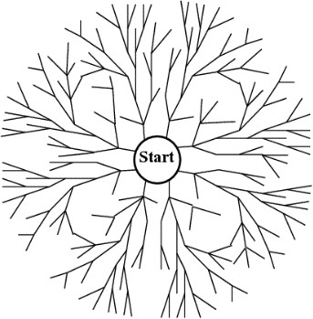




DFS Fringe
Let $m$ be the maximum depth of the graph from Start.
Goal
Space complexity
$$m⋅\left(b−1\right)∈O\left(mb\right)$$
  With backtracking using the system stack, we do not explicitly use back-pointers.
Time complexity
  For a finite tree, we may visit all nodes:
  $$O\left(b^{m}\right)$$
BFS, space time: $O\left(b^{d}\right)$

Slide 22


The Problem with DFS
Finite tree:
Goal
Complete
Yes.
Optimal
No. Stops when the first goal is reached which is not guaranteed to be the best.
Goal
Infinite tree:
Complete
No. May explore infinitely without backtracking toward solution.
Optimal
No.
BFS

Slide 23
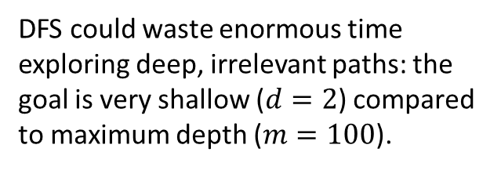
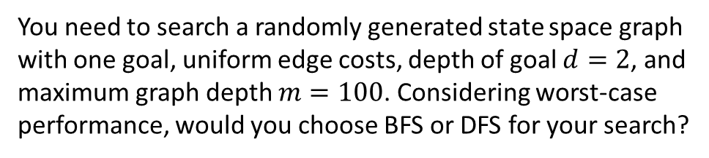
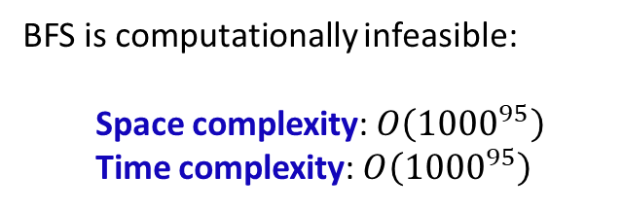
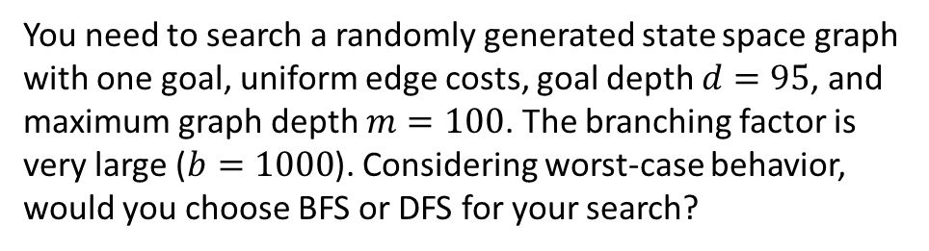
Questions
You need to search a randomly generated state space graph with one goal, uniform edge costs, depth of goal $d=2$, and maximum graph depth $m=100$. Considering worst-case performance, would you choose BFS or DFS for your search?
DFS could waste enormous time exploring deep, irrelevant paths: the goal is very shallow ($d=2$) compared to maximum depth ($m=100$).
BFS
You need to search a randomly generated state space graph with one goal, uniform edge costs, goal depth $d=95$, and maximum graph depth $m=100$. The branching factor is very large ($b=1000$). Considering worst-case behavior, would you choose BFS or DFS for your search?
BFS is computationally infeasible:
  Space complexity: $O\left({1000}^{95}\right)$
  Time complexity: $O\left({1000}^{95}\right)$
DFS

Slide 24
Uniform-Cost Search (UCS)
Suppose we have a graph in which each node has a path cost (i.e., sum of edge costs along the path) from the start node. We want to find a least-cost path to a goal.
Expand the least-cost node first
Use a priority queue to take the least-cost item
This sounds familiar.
Differences
 | Dijkstra's Algorithm | Uniform Cost Search
Implementation | Pre-load all vertices in priority queue | Lazy insertion - add nodes dynamically
Memory Usage | Stores entire graph upfront | Memory-efficient, on-demand generation
UCS and Dijkstra Similarities:
  Explore nodes in order of lowest cumulative cost.
  Use priority queues for minimum-cost selection
  Guarantee optimal paths
UCS is ideal for AI search problems with large or dynamically generated state spaces that cannot be fully stored in memory.

Slide 25

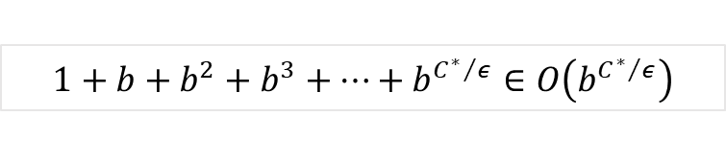
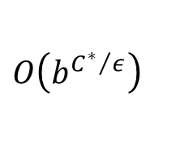
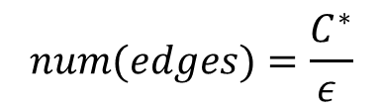
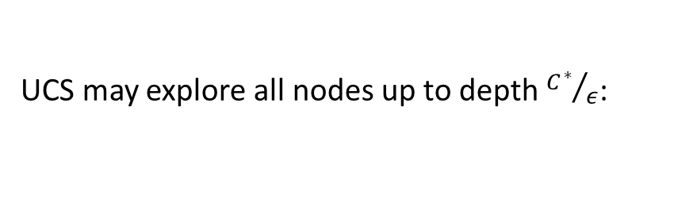
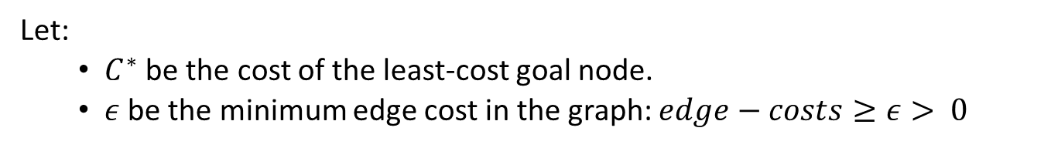


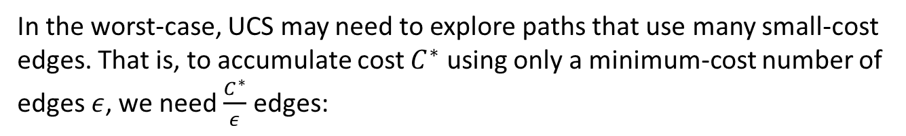

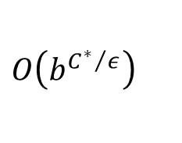

Uniform-Cost Search
Complete?
Yes.
Optimal?
Yes.
Let:
  $C^{∗}$ be the cost of the least-cost goal node.
  $ε$ be the minimum edge cost in the graph: $edge−costs≥ε> 0$
In the worst-case, UCS may need to explore paths that use many small-cost edges. That is, to accumulate cost $C^{∗}$ using only a minimum-cost number of edges $ε$, we need $\frac{C^{∗}}{ε}$ edges:
$$4$$
S
G
$$num(edges)=\frac{C^{∗}}{ε }$$
$$1$$
$$1$$
$$C^{∗}=ε⋅num(edges)$$
$⇔$
A
D
$$1$$
$$1$$
B
$$1$$
C
UCS may explore all nodes up to depth ${C^{∗}}/ε$:
$$1+b+b^{2}+b^{3}+…+b^{{C^{∗}}/ε}∈O\left(b^{{C^{∗}}/ε}\right)$$
UCS expands nodes by cost, not depth, and may follow deep low-cost paths before reaching a shorter but costlier goal path.
Time complexity
  $$O\left(b^{{C^{∗}}/ε}\right)$$
Space complexity
  $$O\left(b^{{C^{∗}}/ε}\right)$$

Slide 26
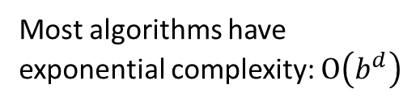
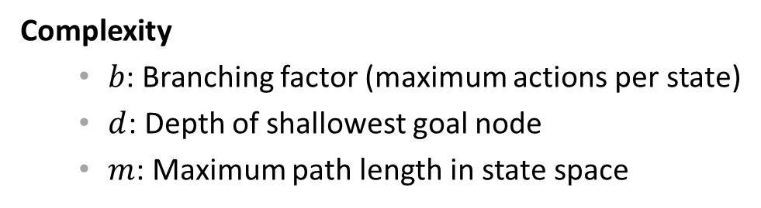
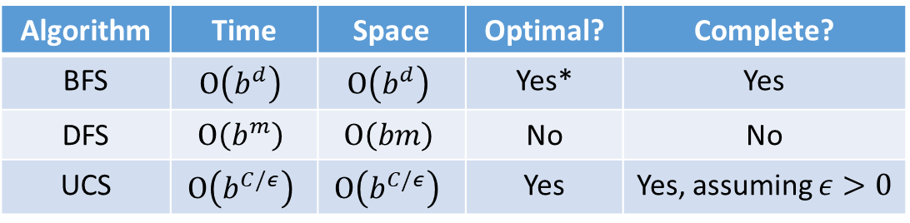
Performance Measures for Search
Completeness | Does it always find a solution if one exists?
Optimality | Does it find a least-cost solution?
Time Complexity | Number of nodes generated/expanded
Space Complexity | Maximum memory needed
Complexity
  $b$: Branching factor (maximum actions per state)
  $d$: Depth of shallowest goal node
  $m$: Maximum path length in state space
  Most algorithms have exponential complexity: $O\left(b^{d}\right)$
Since no search algorithm excels in all measures of time, space, and optimality, choose based on problem-specific constraints and priorities.
Algorithm | Time | Space | Optimal? | Complete?
BFS | $$O\left(b^{d}\right)$$ | $$O\left(b^{d}\right)$$ | Yes* | Yes
DFS | $$O\left(b^{m}\right)$$ | $$O\left(bm\right)$$ | No | No
UCS | $$O\left(b^{C/ε}\right)$$ | $$O\left(b^{C/ε}\right)$$ | Yes | Yes, assuming $ε>0$
* Positive, monotonically increasing edge weights.

Slide 27
Questions to Consider
  Why can we not always do brute-force exhaustive search?
Exhaustive search fails due to exponential growth $O\left(b^{d}\right)$, memory constraints, prohibitive time requirements, and the fact that finding any good solution often suffices.
  What makes some search problems exponentially harder?
Problems become exponentially harder with high branching factors, deep solutions, massive state spaces (like chess), and absence of good heuristics to guide search.
  How do we balance solution quality vs. computational resources?
Balancing quality versus resources involves choosing appropriate algorithms, setting time/memory limits, applying heuristics, and accepting suboptimal solutions when necessary.
  When might DFS be preferred over BFS?
DFS is preferred when memory is limited ($O\left(bm\right)$vs. $O\left(b^{d}\right)$), solutions are likely deep, any solution suffices, or cycles are unlikely in tree-structured problems.
  What information would help guide our search efficiently?
Efficient search needs heuristics estimating goal distance, domain knowledge, cost estimates, and constraint information - motivating informed search algorithms like A*.

Slide 28





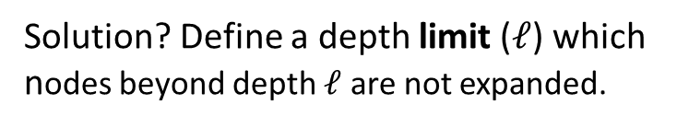






Depth-Limited Search (DLS)
What is the problem with DFS?
Solution? Define a depth limit ($ℓ$) which nodes beyond depth $ℓ$ are not expanded.
Infinite state spaces
Observe, DLS $≡$ DFS when $ℓ=∞$.
Time complexity
  $$O\left(b^{ℓ}\right)$$
Space complexity
  $$O\left(bℓ\right)$$
  $$depth=0$$
S
  $$1$$
  $$2$$
What is the problem with depth-limited DFS?
  $$…$$
Incomplete if $depth(goal)>ℓ$.
  $$ℓ$$
G
What if we iterate by increasing the value of $ℓ$?

Slide 29
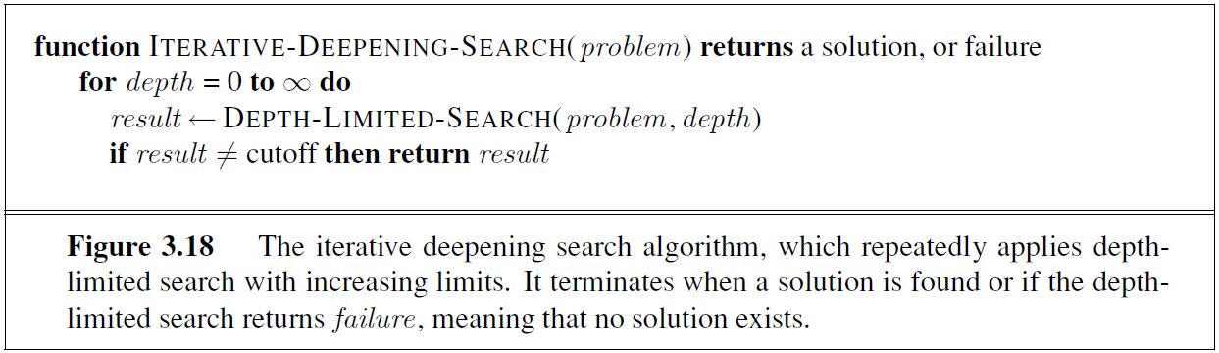
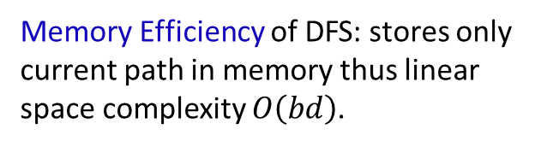
Iterative Deepening
Memory Efficiency of DFS: stores only current path in memory thus linear space complexity $O\left(bd\right)$.
What if we had the best of DFS and BFS?
Completeness guarantee of BFS: systematically explores all depths and will not get stuck in infinite paths.
Problem? What about all the redundancy in which we revisit nodes?

Slide 30


IDS: Mathematically Reasonable Redundancy
Iterative deepening performs depth-limited searches with limits $0, 1, 2, …, d$.
A node at depth $j$ will be visited each iteration from $j$ to $d$: exactly $d − j + 1$ times.
Therefore, the total number of node visits for IDS is given by:
$$N\left(IDS\right)=b^{0}⋅\left(d+1\right)+b^{1}⋅d+b^{2}⋅\left(d−1\right)+…+b^{d}$$
$$∈O\left(b^{d}\right)$$
Intuition.
With exponential expansion, the deepest level dominates the computation:
$N\left(nodes up to depth d\right)=b^{0}+b^{1}+…+b^{d−2}+b^{d−1}=\frac{b^{d}−1}{b−1}∈$ $O\left(b^{d}\right)$
Asymptotically, the redundant work at shallow levels becomes insignificant compared to the work done at the target depth.
So IDS is $O\left(b^{d}\right)$; same as BFS.
Iterative deepening is the preferred uninformed search method when the search state space is larger than can fit in memory and the depth of the solution is not known.

Slide 31








Example: Nodes Expanded by Search
S
$$2$$
$$5$$
$$7$$
Start: S
Goal: G
Consider successor nodes from left to right when there is a tie.
A
B
C
$$4$$
$$2$$
$$8$$
$$4$$
$$5$$
D
E
G
What nodes are visited and what solutions are found by the search technique?
Search | Nodes Visited | Solution Found
BFS
S A B C D E G
S A G
DFS
S A D E G
S A G
IDS
S S A B C S A D E G
S A G
UCS
S A E B D C G
S B G
(UCS is the only uninformed search that worries about costs.)

